Slide 1
Asthma by California County
Christina Ocampo, Mel Phillips, Brandon Ropell, and Andrew Stein

Slide 2


Project Overview
Our team decided to explore if external environmental factors have any impact on asthma prevalence in California and its counties. From this analysis, we would like to propose how clean energy policies can be beneficial both environmentally and for public health. The machine learning model will be used to answer questions regarding why certain counties may be above (True) or below (False) California's collective asthma rate of 8.8%
https://www.everydayhealth.com/asthma/guide/
https://pixy.org/4567849/

Slide 3
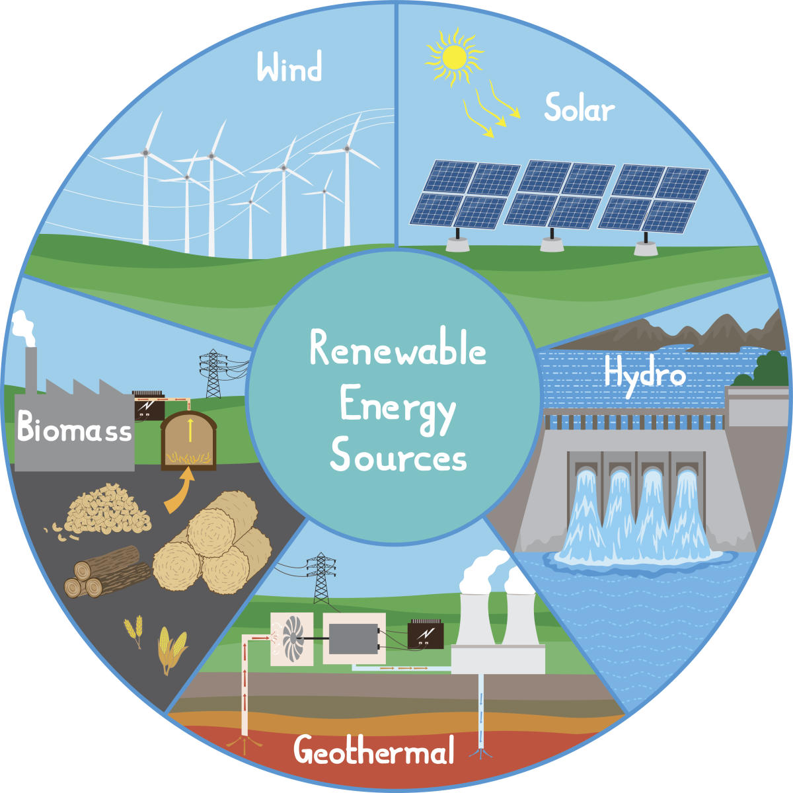
Data Resources
Asthma Rates
Wildfire Data
Air Pollution Data
Demographics
Registered EVs
EV Charging Stations
Clean Energy Generation
California Electric Substations
Zip Code Database
https://www.deccanherald.com/sites/dh/files/styles/article_detail/public/article_images/2020/05/19/661665-2134213709-1519709316.jpg?itok=TRr3Ryqe

Slide 4
Data Exploration
Several datasets will be represented with pie charts to show key areas that will affect the analysis
Explore outliers using box and whisker plots in the following datasets
Asthma (searching for outliers in Prevalence)
Air Pollutants (searching for outliers in pollutant value)

Slide 5


Databases/Technology
Preprocess the files via Python: cleaning up data, columns, ensuring consistency in data for merging, replacing Asthma Prevalence level from numerical values to True or False if the original value was above or below the 8.8% average.
Created a Database via PostgreSQL joining all the columns on the “County” column.
Cleaning up database as we continued to merge columns to ensure duplicate “County” columns were removed
https://www.iconfinder.com/icons/4518857/python_icon
https://commons.wikimedia.org/wiki/File:Postgresql_elephant.svg

Slide 6
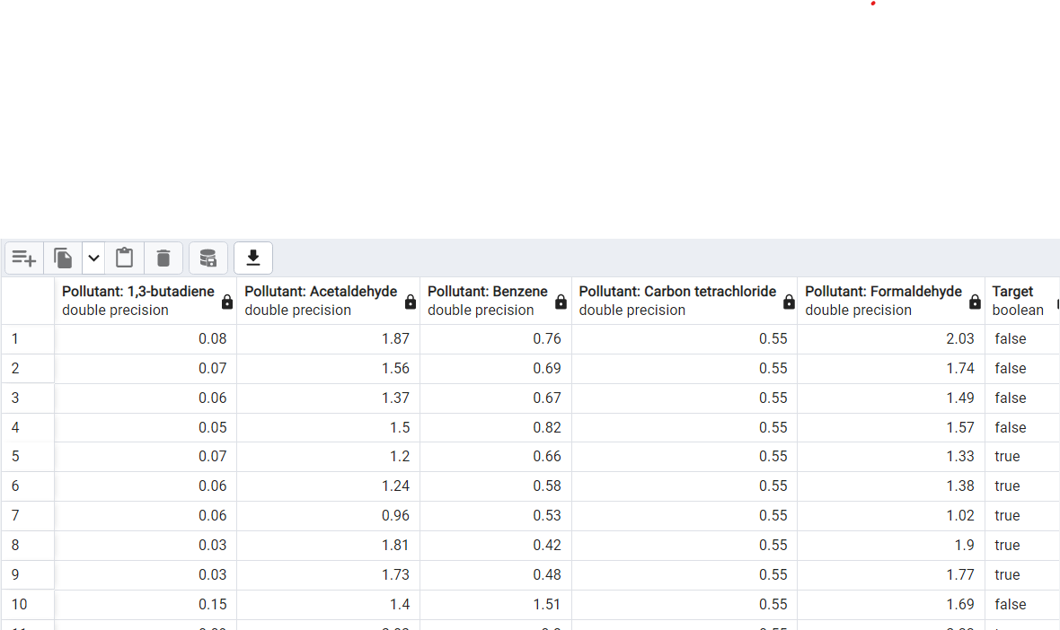
Database Example

Slide 7
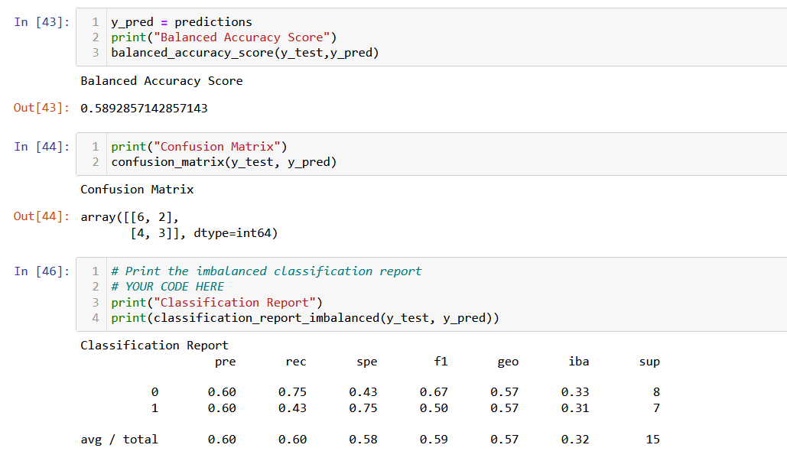
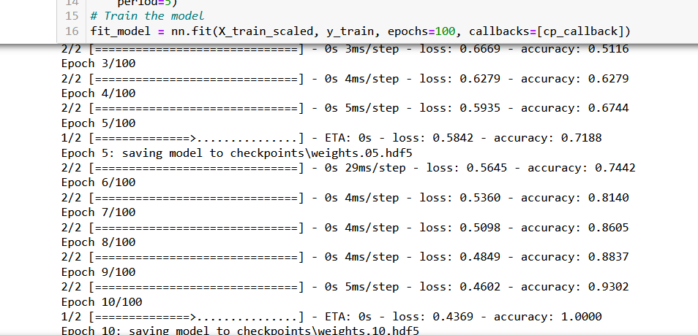
Machine Learning Model
How accurately the models can predict whether or not Asthma Prevalence will be above or below 8.8%.
Two models will be tested:
Balanced Random Forest Classification Model
Neural Learning Model
Limitation: Dataset is too small for these model to train properly

Slide 8

Dashboard
A Tableau Dashboard was used to visualize the project https://public.tableau.com/app/profile/mel.phillips/viz/Asthma_Workbook/WhyAsthma?publish=yes
https://logos-world.net/tableau-logo/

Slide 9
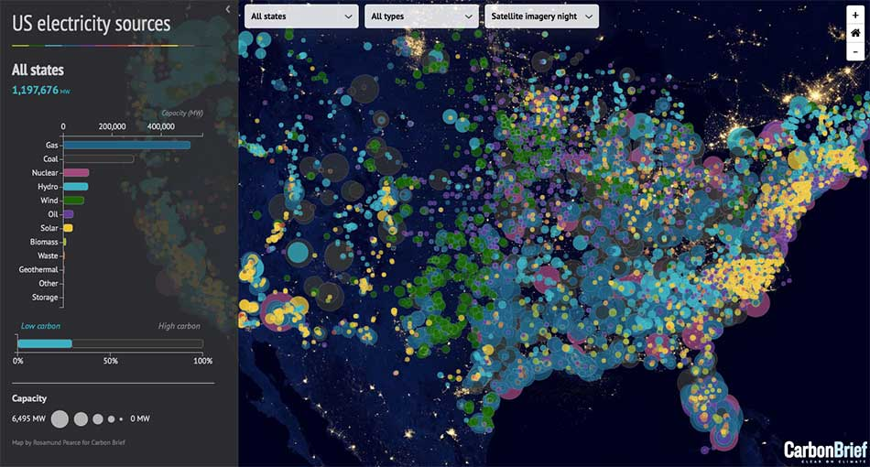
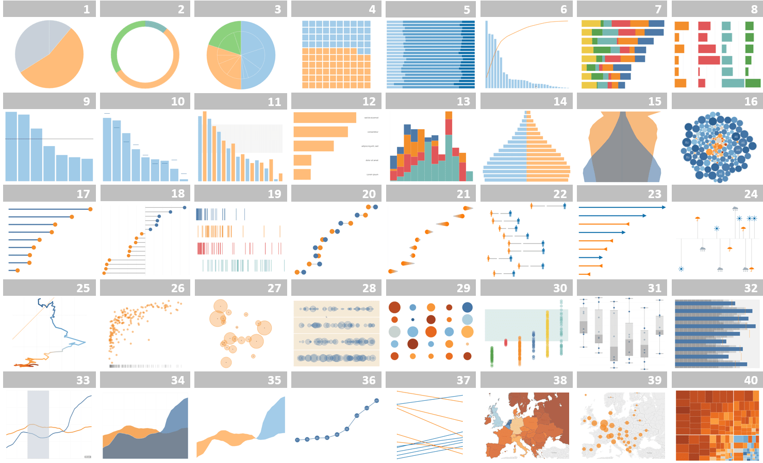
Tools/Elements
Map
Filter Options
Charts
https://cdns.tblsft.com/sites/default/files/pages/energy2.jpg
https://cdns.tblsft.com/sites/default/files/blog/wordless.png

Slide 10
Storyboard
Presentation Overview
Map of Asthma Prevalence per County
Asthma by demographics
Why Asthma?
Closing statements: issues, what was found and what can be achieved
Conclusionary findings
Asthma by Electrical Vehicles
Asthma by Environmental Factors

Slide 11
Resources
Cali Clean Energy Generation https://cecgis-caenergy.opendata.arcgis.com/documents/CAEnergy::2019-utility-scale-renewable-electrical-generation-totals-by-county-energy-produced/explore
Demographics https://www.kaggle.com/datasets/muonneutrino/us-census-demographic-data?select=acs2017_county_data.csv
Asthma Rates https://data.world/chhs/01f456c3-db34-44f2-a52c-6811bef8ba6d
Air Pollution https://ephtracking.cdc.gov/DataExplorer/?c=11
EV Charging Stations https://www.kaggle.com/datasets/prasertk/electric-vehicle-charging-stations-in-usa
Wildfire Data https://www.kaggle.com/datasets/ananthu017/california-wildfire-incidents-20132020
Registered EVs https://www.atlasevhub.com/materials/state-ev-registration-data/#data
Zip Code Databases https://www.unitedstateszipcodes.org/zip-code-database/
California Electric Substations https://data.cnra.ca.gov/dataset/california-electric-substations1/resource/8077a564-ea00-49b7-8ca2-304f4dc16604

